Slide 1

CSE 473
Pattern Recognition

Slide 2
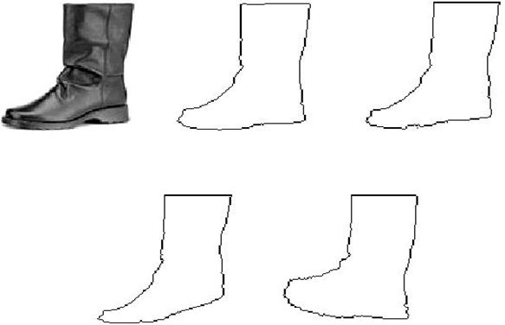
Template Matching

Slide 3
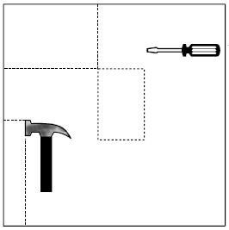

Computation Considerations in Correlation Based TM (2)
Limit the search space
  Search only in the area of [-p, p] X [-p, p] centered at (x, y)
r
(x, y)
(x - p, y - p)
(x + p, y + p)

Slide 4
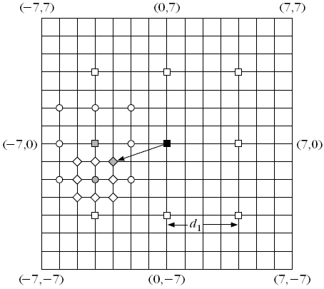
Computation Considerations in Correlation Based TM (3)
2D Logarithmic search
  Start with a rectangle of size [-p, p] X [-p, p]

Slide 5
Computation Considerations in Correlation Based TM (3)
2D Logarithmic search
  Search only at 9 points separated by d₁

Slide 6
Computation Considerations in Correlation Based TM (3)
2D Logarithmic search
  Maximum found at dark red

Slide 7
Computation Considerations in Correlation Based TM (3)
2D Logarithmic search
  Search in the rectangle of size [-p/4, p/4] X [-p/4, p/4] centered at dark red

Slide 8
Computation Considerations in Correlation Based TM (3)
2D Logarithmic search
  Maximum found at green

Slide 9
Computation Considerations in Correlation Based TM (3)
2D Logarithmic search
  Search in the rectangle of size [-p/8, p/8] X [-p/8, p/8] centered at green

Slide 10
Computation Considerations in Correlation Based TM (3)
2D Logarithmic search
  Maximum found at purple

Slide 11
Computation Considerations in Correlation Based TM (3)
Complexity MN(8k+1)

Slide 12
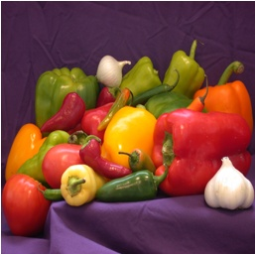

Computation Considerations in Correlation Based TM (4)
Hierarchical Search
  Search the reference in the area of size [-p, p] X [-p, p] centered at (x, y)
  Let, reference be of size 16X16
reference
test

Slide 13


Computation Considerations in Correlation Based TM (4)
Hierarchical Search
Level 0
Low pass Filter of Level 0
Original reference and test image

Slide 14


Computation Considerations in Correlation Based TM (4)
Hierarchical Search
Sub-sampled by 2
Level 0
Low pass Filter of Level 0
Level 1

Slide 15



Computation Considerations in Correlation Based TM (4)
Hierarchical Search
Level 1
Low pass Filter of Level 1
Sub-sampled by 2
Level 2

Slide 16
Computation Considerations in Correlation Based TM (4)
Hierarchical Search
. . . .
Level 0
Level 1
Level 2

Slide 17
Computation Considerations in Correlation Based TM (4)
Hierarchical Search

Slide 18
Computation Considerations in Correlation Based TM (4)
Hierarchical Search
2p
2p
(x, y)

Slide 19
Computation Considerations in Correlation Based TM (4)
Hierarchical Search
p/2
p
2p
(x/2, y/2)
(x/4 y/4
(x, y)
Level 0
Level 1
Level 2

Slide 20
Computation Considerations in Correlation Based TM (4)
Hierarchical Search
  Start at Level 2 with the reference of size 4X4
  Search in the rectangle [-p/4, p/4] [-p/4, p/4] centered at (x/4, y/4)

Slide 21
Computation Considerations in Correlation Based TM (4)
Hierarchical Search
  Start at Level 2 with the reference of size 4X4
  Search in the rectangle [-p/4, p/4] [-p/4, p/4] centered at (x/4, y/4)
  Let optimal found at (x₁, y₁) with respect to (x/4, y/4).

Slide 22
Computation Considerations in Correlation Based TM (4)
Hierarchical Search
  At Level 1, with the reference of size 8X8
  Search in the rectangle [-1, 1] X [-1, 1]
  centered at (x/2 +2x₁, y/2+2y₁)

Slide 23
Computation Considerations in Correlation Based TM (4)
Hierarchical Search
  At Level 1, with the reference of size 8X8
  Search in the rectangle [-1, 1] X [-1, 1]
  centered at (x/2 +2x₁, y/2+2y₁)
  Let optimal found at (x₂, y₂) with respect to (x/2, y/2).

Slide 24
Computation Considerations in Correlation Based TM (4)
Hierarchical Search
  At Level 0, with the reference of size 16X16
  Search in the rectangle [-1, 1] X [-1, 1]
  centered at (x +2x₂, y+2y₂)

Slide 25
Computation Considerations in Correlation Based TM (4)
Hierarchical Search
  At Level 0, with the reference of size 16X16
  Search in the rectangle [-1, 1] X [-1, 1]
  centered at (x +2x₂, y+2y₂)
  Location at this time is the final one

Slide 26
Computation Considerations in Correlation Based TM (4)
Complexity of Hierarchical Search
  9 × No. of Decompositions +
  Complexity at highest level

Slide 27
Deformable Template Matching
Why is This?
  Test and reference patterns are seldom exact
  Rather, they are ‘similar’
  In CBIR, query sketch significantly differs from the shapes in image DB

Slide 28
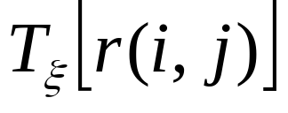
Deformable Template Matching
The philosophy: Given a reference pattern r(i,j) known as prototype:
  Deform the prototype to produce different variants. Deformation is described by the application of a parametric transform on r(i,j):
  Match the test pattern with each of the deformed patterns

Slide 29


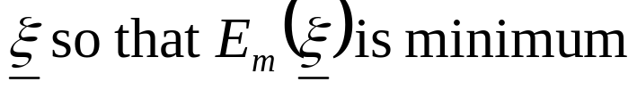
Deformable Template Matching
For different values of the parameter , the goodness of fit with the test pattern is given by the matching energy:
The goal is to chose

Slide 30

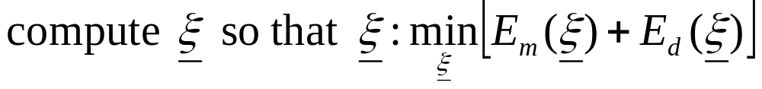
Deformable Template Matching
However, the higher the deformation, the higher the deviation from the prototype. This is quantified by a cost known as deformation energy:
In deformable template matching,
Thus target: small deformation and small matching energy

Slide 31
Deformable Template Matching
The essential elements
  A prototype of the reference
  Transformation function
  Matching Energy cost
  Deformation Energy cost

Slide 32
Deformable Template Matching
The prototype of the reference
  Should be representable
  Capture the mean shape characteristics of an object

Slide 33

Deformable Template Matching
Transformation function
  Any appropriate parametric operation
  A suitable transformation is:

Slide 34
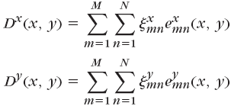


Deformable Template Matching
Transformation function
  Any appropriate parametric operation
  A suitable transformation is:
where,

Slide 35

Deformable Template Matching
Deformation Energy cost
  Alternately,

Slide 36

Deformable Template Matching
Matching Energy cost
  Captured as a function of point-to-point distance between reference and test pattern:

Slide 37


Deformable Template Matching
Matching Energy cost
  Captured as a function of point-to-point distance between reference and test pattern:
    is the displacement of the (i, j) pixel of the deformed template from the nearest pixel of the test template
    ρ is a constant
where,

Slide 38
Context Dependent Classification

Slide 39
Context Dependent Classification
Recall context free classification
  No relation exist among classes
  No relation exists among objects (feature vectors)
  A new object is classified to any class independent of the previous objects’ classes

Slide 40
Context Dependent Classification
In Context dependent classification, the class of a feature vector depends on
  Its own value
  Value of other feature vectors
  Classes assigned to other vectors

Slide 41
Context Dependent Classification
Application
  Communication
  Image Processing
  Signal Processing

Slide 42
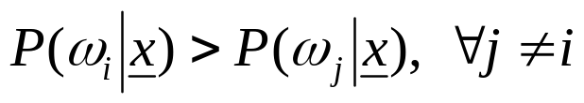
Solution for Context Dependent Classification
Recall Bayesian formulation for context free classification
  Assign x to ω_{i} if
In context dependent classification, we cannot apply it directly because of interdependency of features and classes

Slide 43
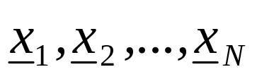
Solution for Context Dependent Classification
This interrelation demands the classification to be performed simultaneously for all available feature vectors
we assume that the training vectors
occur in sequence, one after the other and we will refer to them as observations

Slide 44
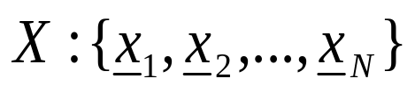



Context Dependent Bayesian Classifier
Let be sequence of observations
Let be the available M classes
Let be a possible sequence of assigned classes, that is
  where,
There are M^{N} of

Slide 45
Context Dependent Bayesian Classifier
Now, given and
Classify X to using the Bayesian rule
This is equivalent to classifying

Slide 46
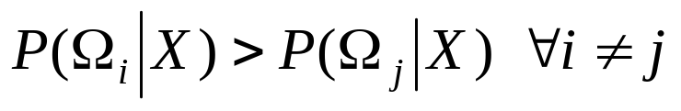

Context Dependent Bayesian Classifier
The rule
can be simplified as

Slide 47
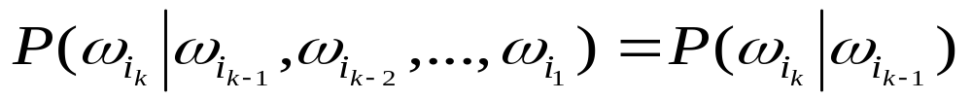
Further Simplification: Markov Chain Model
Markov Chain Models (for class dependence)
which means class dependence is limited to only within two successive classes

Slide 48
Further Simplification: Markov Chain Model
Markov Chain Models (for class dependence)
in other words,
if
then
depends on the class from which observation x_{k-1}, at stage k-1 has occurred

Slide 49

Further Simplification: Markov Chain Model
Markov Chain Models (for class dependence)
Therefore, we can write

Slide 50

Further Simplification: Markov Chain Model
Markov Chain Models (for class dependence)
Therefore, we can write
We find,

Slide 51

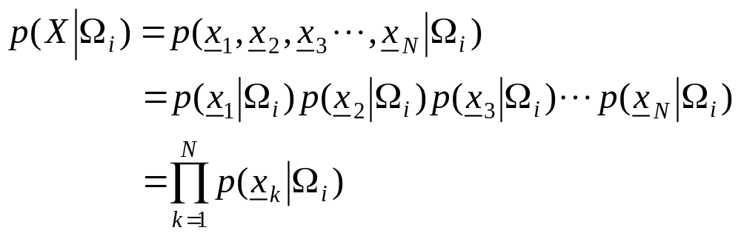
Further Simplification: Markov Chain Model
Further assumption
  statistically mutually independent

Slide 52
Further Simplification: Markov Chain Model
Further assumption
  statistically mutually independent
  If the pdf in one class is independent of the others, then

Slide 53
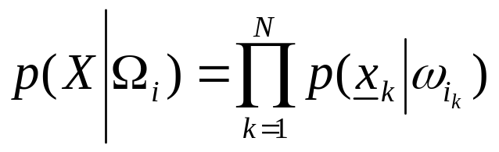
Further Simplification: Markov Chain Model
Further assumption
  statistically mutually independent
  The pdf in one class independent of the others, then
  Finally,

Slide 54
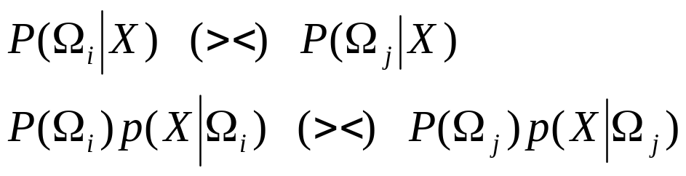
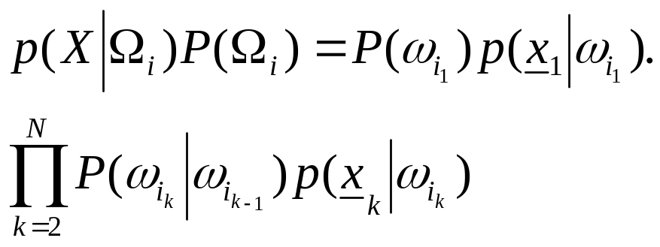
Further Simplification: Markov Chain Model
From the above, the Bayes rule is readily seen to be equivalent to:
that is, it rests on
To find the above maximum in brute-force task we need Ο(NM^{Ν} ) operations!!

